Slide 1
Capstone Project - The Battle of Neighborhoods (Week 2)
Where should I open a European-style Vegetarian restaurant in India?

Slide 2
Business Problem
A customer wants to open a new European style vegetarian restaurant in Delhi and Mumbai in India.
Since India is a diverse country accommodating both foreign and local communities, my customer has asked me to help him in finding the best location for his first restaurant of his food chain in Delhi and Mumbai.
Since Delhi is the capital of India and Mumbai being the financial capital, it attracts both foreigners and nationals to establish their business, or to study or for tourism.
Delhi itself has 7 districts with 73 locations and Mumbai has 12 districts with 114 locations. We aim to find a location with good amount of people and low competition.

Slide 3
Data
In order to find a good location we will need to analyse the neighbourhood of Delhi and Mumbai. The following csv file can be used for this:
  https://github.com/pareshprakash/capstone-project/Delhi-District.csv
  https://github.com/pareshprakash/capstone-project/blob/master/Mumbai-District.csv
The Four Square API can be used to compare the neigbhborhood of Delhi and Mumbai and based on the comparison we can choose a location for the restaurant.
We need to find out localities which are full of convenience stores, restaurants, train station, airport terminals.

Slide 4
Methodology
For each location in Delhi and Mumbai, all convenience stores, restaurants, train station data was found out using the Four Square API.
The number or ratio of each of them was then computed.
The data was then arranged to find out the most common venue in each of the districts arranged in descending order.
K-means clustering was used to analyse the neighbourhood and find out the location with the highest number of the above locations.
Based on the clusters, the location with the maximum number of people can be identified and then that location can be analysed for convenience stores, restaurants, train station and airport.
The analysis made can then be used to determine if that location is an ideal location for the customer or not.

Slide 5
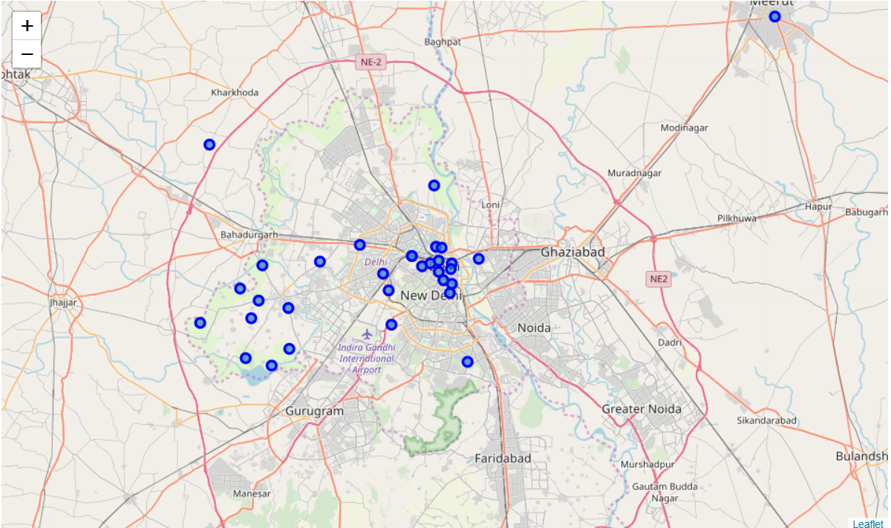
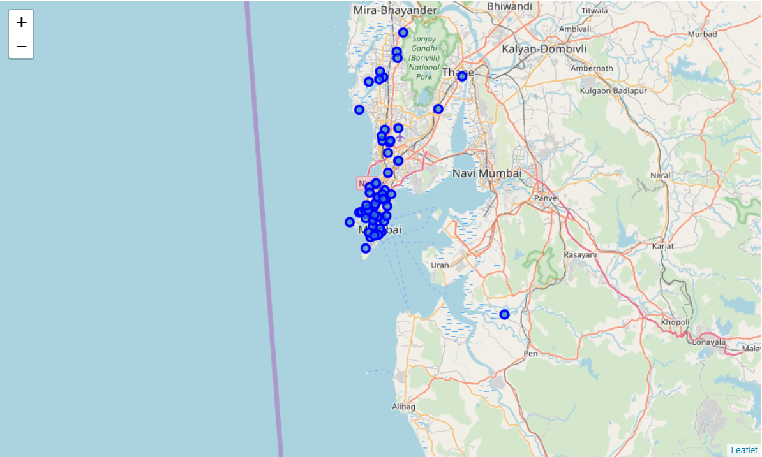
Locations in DELHI
Locations in MUMBAI
According to the maps we can find out the most dense localities in Delhi and Mumbai and can make our progress from those locations.
Chosen locations are South Delhi, Delhi and Mumbai Central, Mumbai

Slide 6
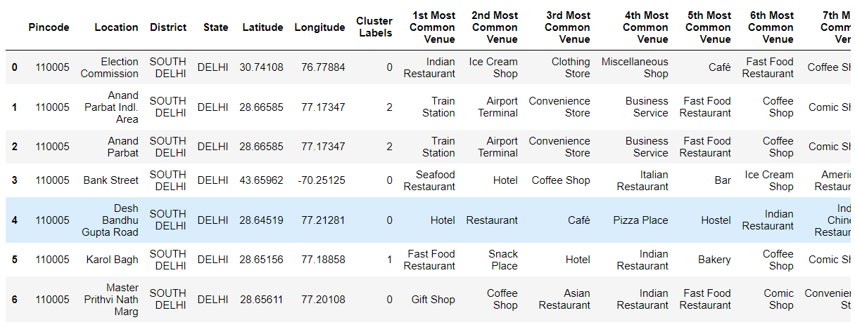
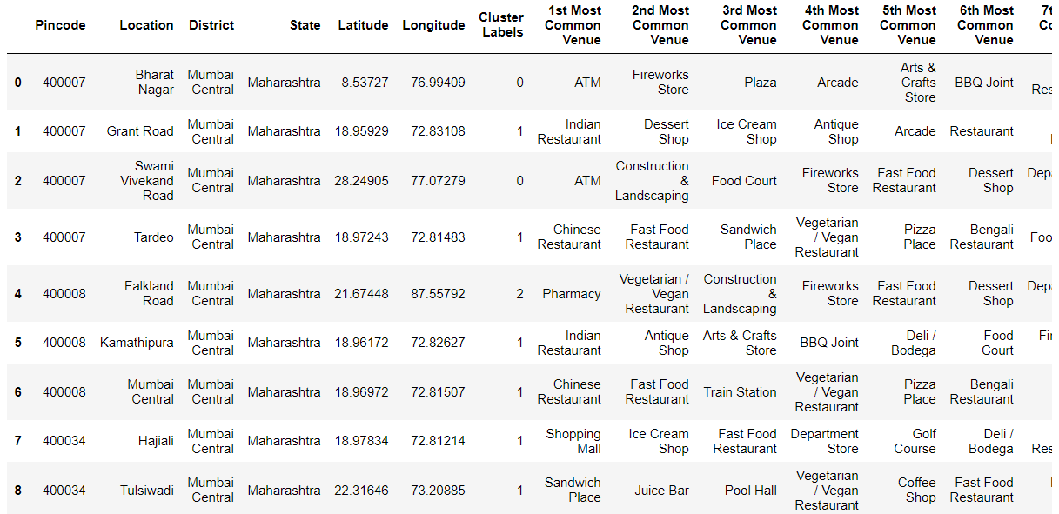
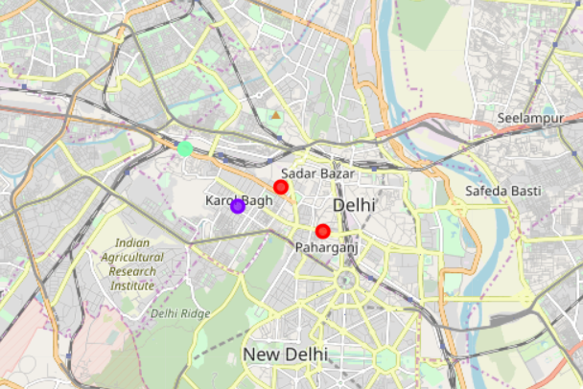
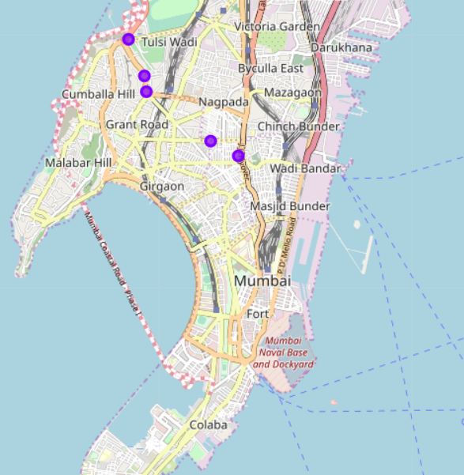
After the k-means clustering was done, the resulting clusters with the maximum density and the most common venues in Delhi and Mumbai was then identified.

Slide 7
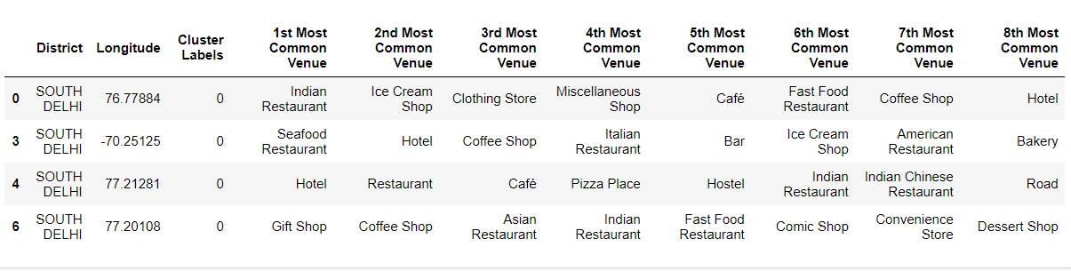
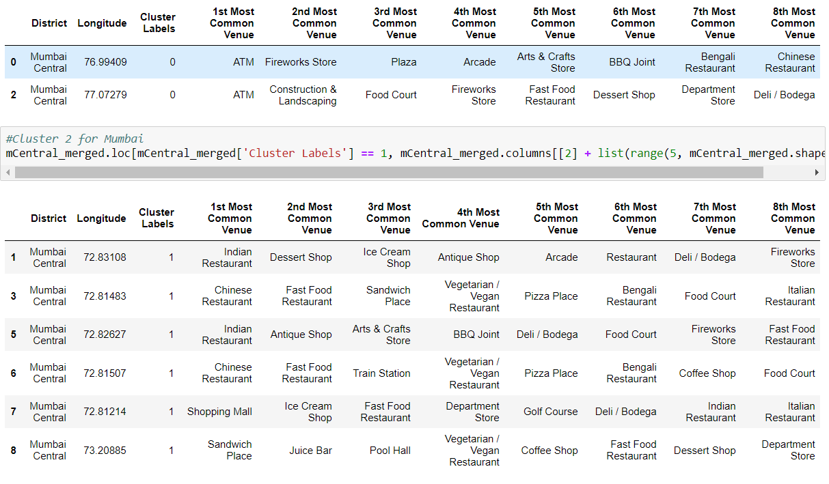
Results
After analysing the cities we were able to find out the most common venues in both the cities
Delhi
Mumbai
The most common venue found out to be restaurants. Thus this location can be chosen but it already possesses a lot of competition.
The most common venue has highest number of ATMs but the second most common location has a large number of restaurants. Thus this location is a good option but has a high competition.

Slide 8
Discussion
Based on cluster for each cities above, we believe that classification for each cluster can be done better with calculation of venues categories (most common) in each cities. Referring to each cluster, we can't determine clearly what represent in each cluster by using Foursquare - Most Common Venue data.
However, we can make an assumption about each cluster as follow:
Cluster 1: Delhi: Gift Shop
Cluster 2: Delhi: Restaurants
Cluster 3: Delhi: Train Station
Cluster 1: Mumbai: Indian Restaurants
Cluster 2: Mumbai: Mix Cuisine Restaurants
Cluster 3: Mumbai: Vegetarian Restaurants
What is lacking at this point is a systematic, quantitative way to identify and distinguish different district and to describe the correlation most common venues as recorded in Foursquare. The reality is however more complex: similar cities might have or might not have similar common venues. A further step in this classification would be to find a method to extract these common venues and integrate the spatial correlations between different of areas or district.
We believe that the classification we propose is an encouraging step towards a quantitative and systematic comparison of the different cities. Further studies are indeed needed in order to relate the data acquired, then observe it to more meaningful and objective results.

Slide 9
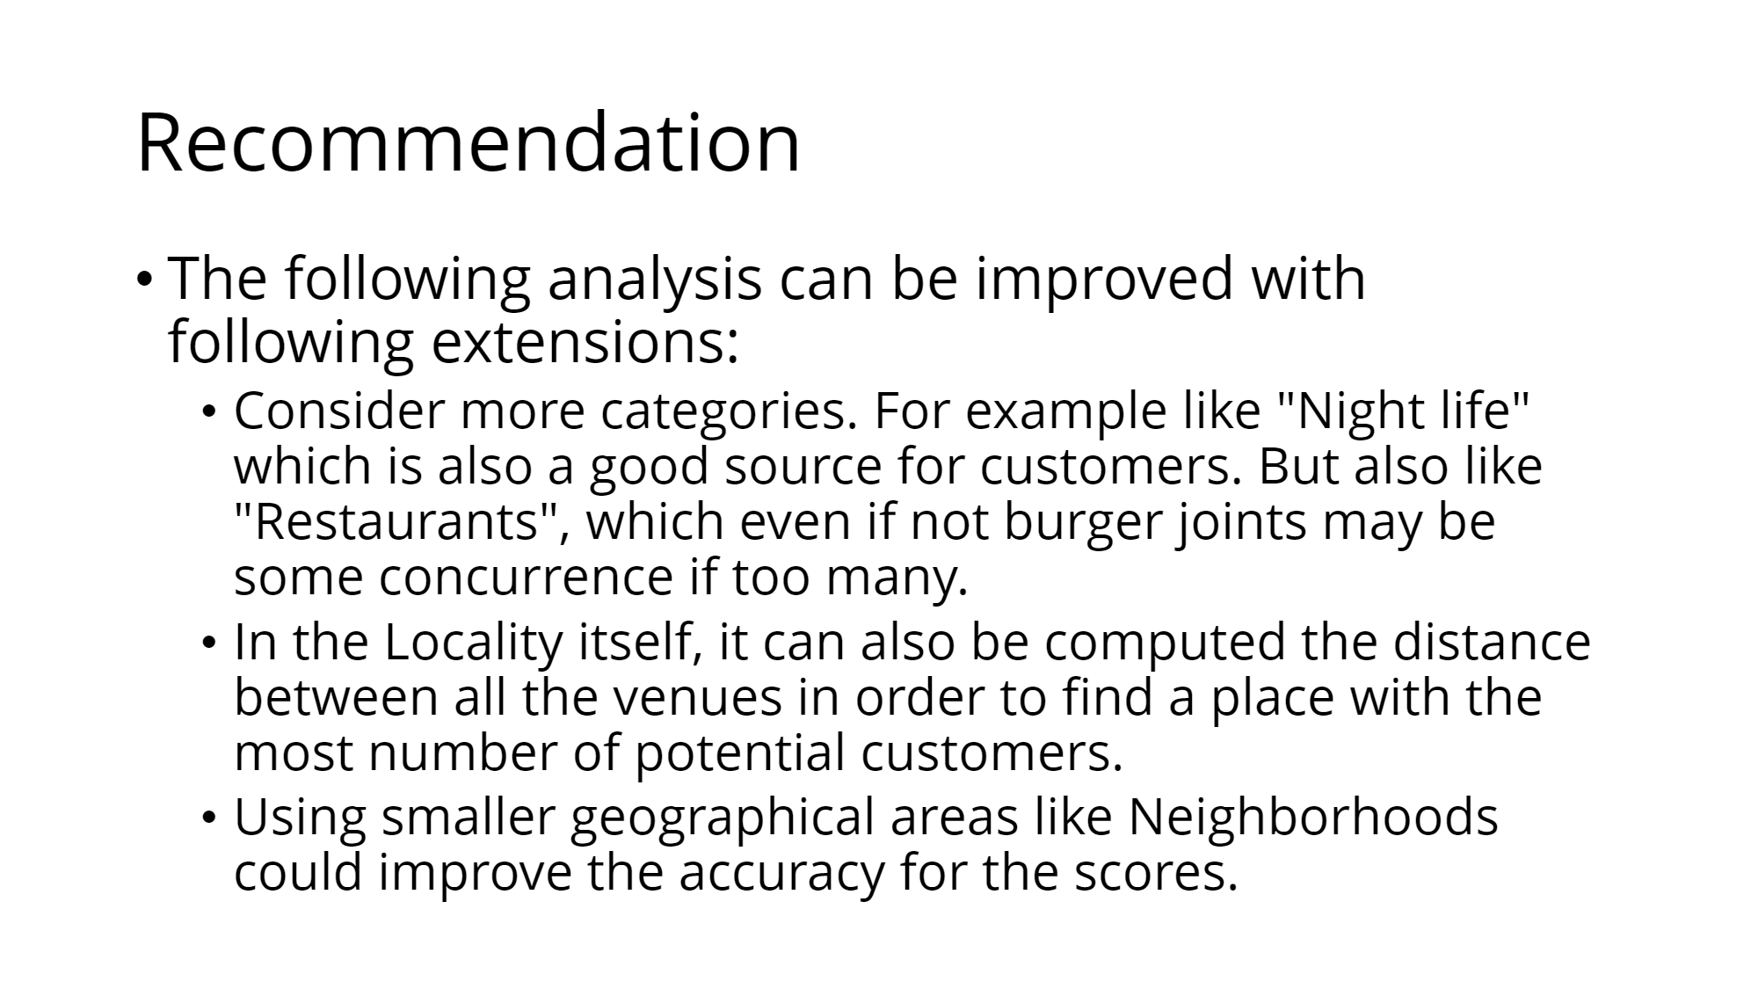
Recommendations

Slide 10
Conclusion
Using Foursquare API, we can captured data of common places all around the world. Using it, we refer back to our main objectives, which is to determine;
  The similarities or dissimilarities in both the cities
  Classification of area located inside the city whether it is restaurant, gift place, or others
In conclusion, both cities Delhi and Mumbai are the center of attraction among India. However, to declare both cities are similar or dissimilar base on common venues visited is quite difficult. Both cities is similar in some venues also dissimilar in certain venues. And for classitification based on common venues, again we must have more systematic or quantitative way to identify and declare this. Comparison can be made, but no such method or quantitative data to determine this. We hope in the future, a method to determine it can be establish and explore for references.

